Slide 1





K.A.M.A.L.A
Kapidhwaj Association of Modern logic, Automation, Learning and career Advancement
News Delivery Agent
AI-powered News Delivery via Discord
PRESENTED BY:
PRESENTED TO:
Dipayan Nandi
Ai Agents Workshop - Mini Hackathon
Kapidhwaj Innovations Pvt Ltd

Slide 2
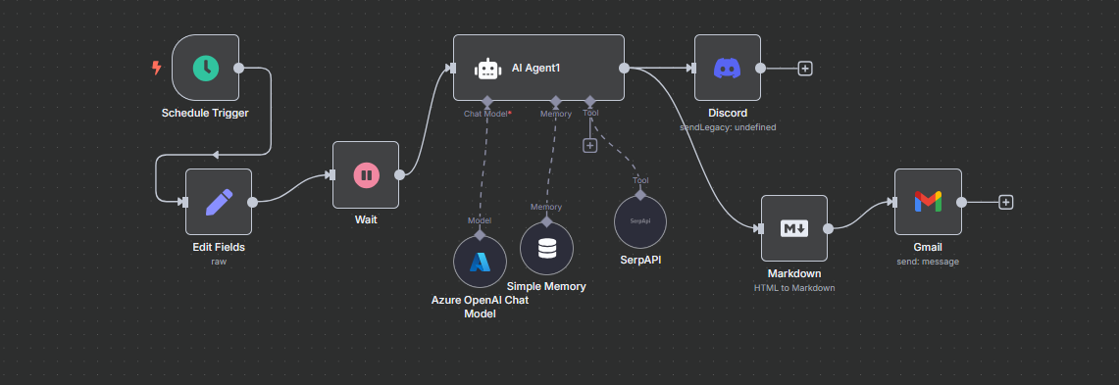
K.A.M.A.L.A
Kapidhwaj Association of Modern logic, Automation, Learning and career Advancement
WORKFLOW DIAGRAM

Slide 3
K.A.M.A.L.A
Kapidhwaj Association of Modern logic, Automation, Learning and career Advancement
USE CASE
Scheduler generates timestamp and is set to auto-activate the workflow at every 6 hours interval.
User’s interests are predefined.
Based on this the user agent searches for the latest news relating to the topics the user wants
Searches are made using SerpAPI
The model sends the requested info in 2 forms
One: as a message on Discord via a webhook
Two: it converts the message into markdown and forwards it to your Gmail.

Slide 4
K.A.M.A.L.A
Kapidhwaj Association of Modern logic, Automation, Learning and career Advancement
ADVANTAGES
Sends the latest news to the user without prompting
Sends it in multiple places to maximize the chances of the user viewing it
Has predefined the user interests so that it does not send irrelevant info.

Slide 5
K.A.M.A.L.A
Kapidhwaj Association of Modern logic, Automation, Learning and career Advancement
FUTURE SCOPE
Add a feature where each user can instead send a list of interests, his/her timezone to the agent once. This ensures that the AI agent can be personalized to multiple users.
Resolve issues caused by API rate limits, multiple requests, etc.
Resolve errors with GMail OAuth2 authentication.

